Slide 1
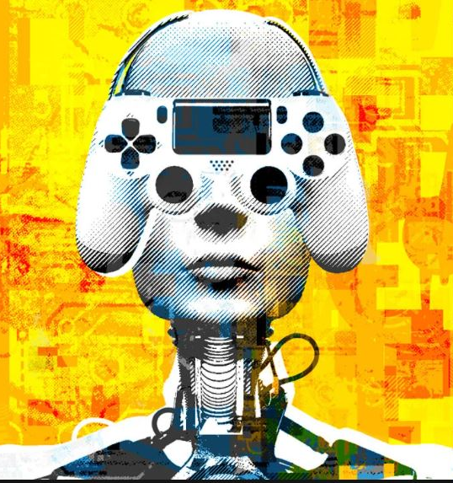
Training agent for
first-person shooter (FPS)
game with Actor-critic Curriculum learning
First Skill
Second Skill

Slide 2
Md. Ariful Islam
2019-1-60-140
Sazzad Hossen
2019-1-60-063
Presented By-
Rawnak Jahan Taifa
2019-1-60-134
Syeda Tasfia Tasnim
2019-1-60-137
Monjurul Alam
2018-3-60-035

Slide 3
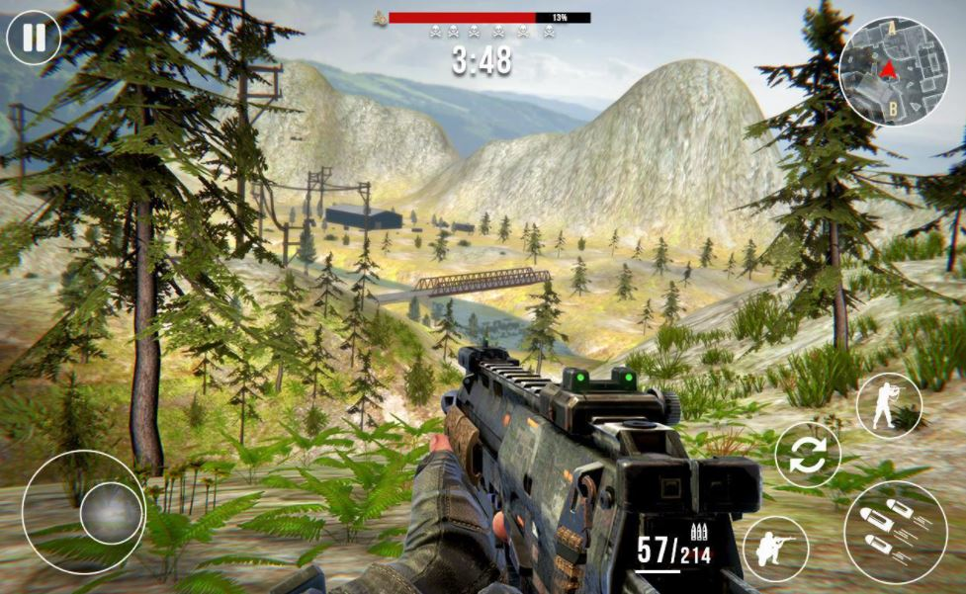
Introduction
What is FPS(First-person shooter ) game?
How is it related to reinforcement?

Slide 4
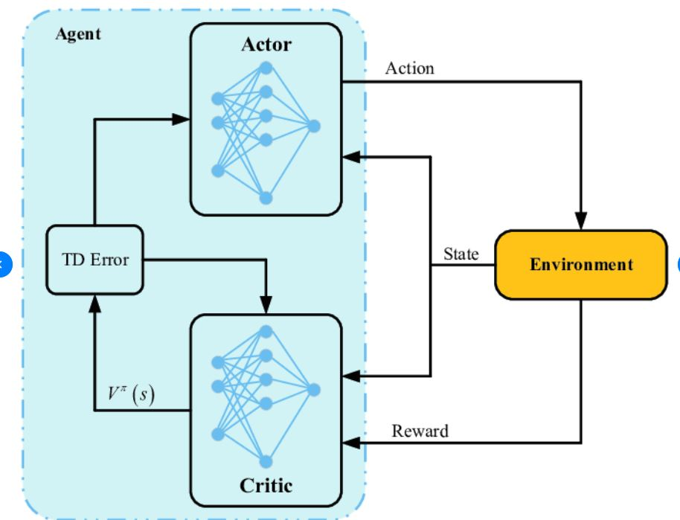
Actor Critic Model

Slide 5
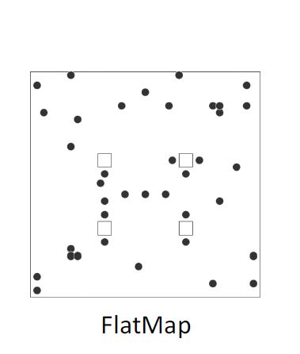
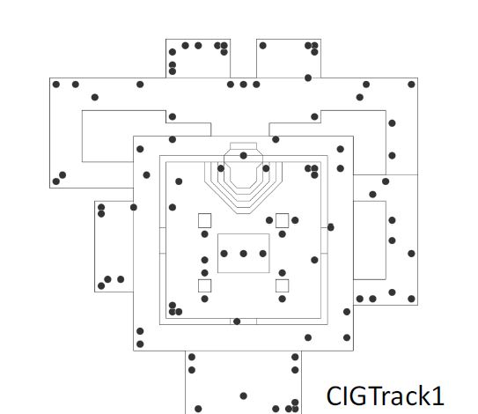

Slide 6
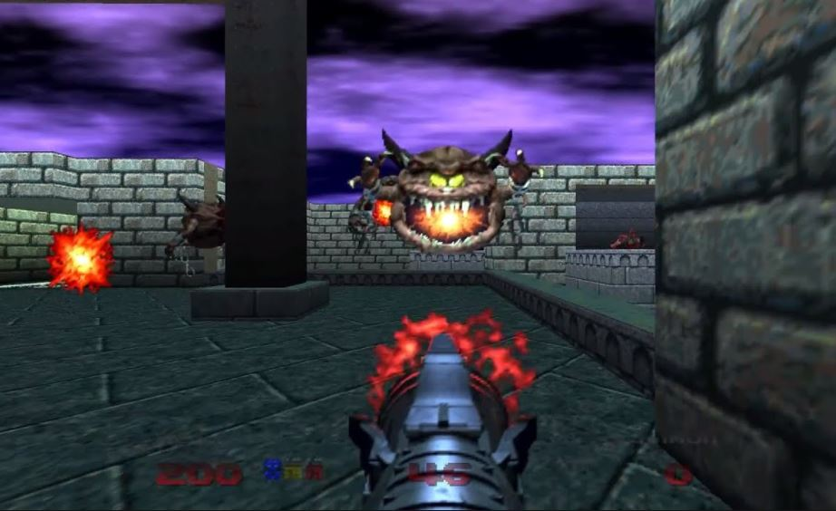
DOOM AS A REINFORCEMENT LEARNING PLATFORM
Doom is a first person shooter game released in 1993.
Agent make decisions considering the environment.
The doom game is modified by VizDoom.

Slide 7
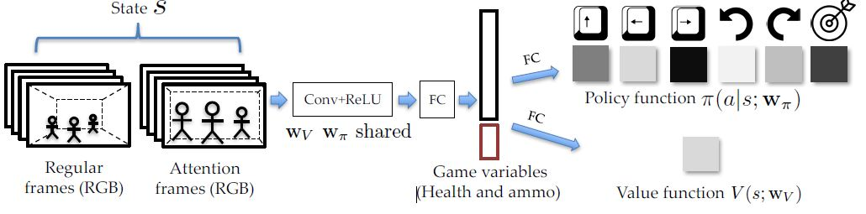
What are the steps are following for completing FPS game?
Network architecture :

Slide 8
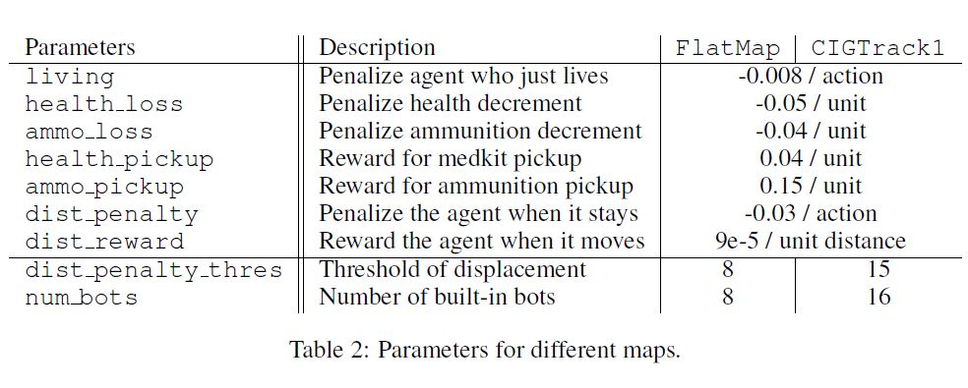
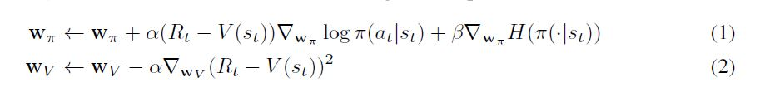
Training Pipeline:

Slide 9

Curriculum learning
Reward Shaping
Curriculum Design
Adaptive curriculum

Slide 10
Post-training Rules:
Internal tournament
Behaviors
Tactics

Slide 11
Conclusion
Design methodology of a new framework
Challenges for training an agent
Limitations and planning.

Slide 12
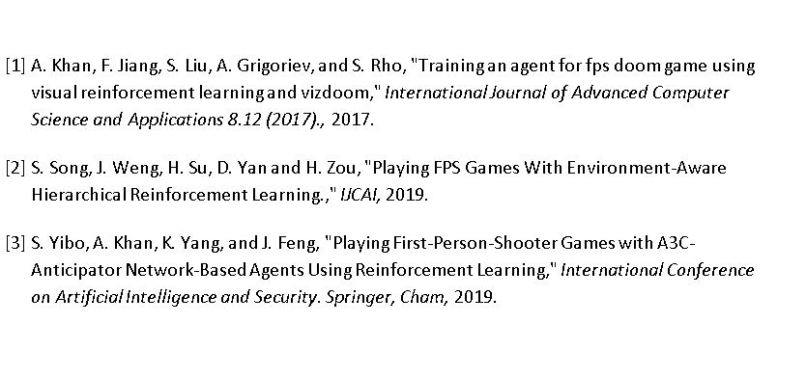
References:

Slide 13
Thank You

